Slide 1
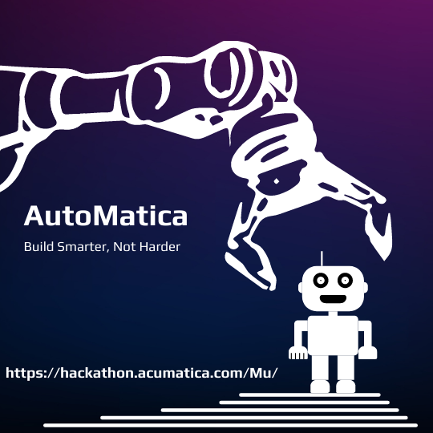
Hackathon 2023 – Team Mu

Slide 2
Team Mu
Presented by
Ideation
Generation
Screening
Use Case
Code Development & Testing
Criterion Scoring
Key Benefits
Future Scope

Slide 3
Team Mu
Name | Company | Title
Patrick Chen | SPS Commerce | Staff Software Engineer
Harsha Sarjapur | Info Sourcing Inc. | President
Chetan Srinivas G | Kensium Solutions | Product Manager
Shawn Goodwin | Martin and Associates | Senior Consultant
Paul Gilfoy | PriceKubecka | Integration Engineer
Brandon Sproul | Blytheco | Acumatica Consulting Manager
Vidhya Hariharasubramanian | Acumatica | Technical Account Manager

Slide 5
Ideation

Slide 6
Generation
Partners, developers, customers and ISV often customize Acumatica and deploy packages and often run into issues with compatibility issues, and errors leading to a delay These primarily impact their own custom packages / an ISV solution / developer package. Currently, this is a manual process wherein the administrator is unable to publish the packages on-demand in production, which includes wait time till end of the day or lockout and then publish, for minimal impact on business Upon encountering an error, the requirement is to communicate that to other stake holders and often they must work through partners, before reaching out to the development world for bug fixing.

Slide 7
Screening
Automate Customization Manager for scheduled upgrades by importing the packages By using ACU scheduler, the admin sets up the schedule they could notify all package owners on the chosen slot or package publish being attempted and, be able send emails out. Create a Package Owner profile, for each package we key in the profile which will contain the record of Contact Person, Email ID, and Technical Contact (From ACU contacts). The package gets published and if there are any issues it sends an email with trace or issue to all concerned tech teams of package owners notifying the issue (ACU Email template). The package owner gets notified if there is success or failure, this can be also ACU support teams if required. We also create a task for Admin in the same instance notifying to follow up with package owners.

Slide 8
Use Case

Slide 9
Case Description

Slide 10
Code Development & Testing

Slide 11
Coding Approach

Slide 12
Criterion Scoring

Slide 13
Scoring
Criteria | Score | Explanation
Creativity
Completeness
Technical Difficulty
Usefulness

Slide 14
Key Benefits & Future Scope

